Slide 1
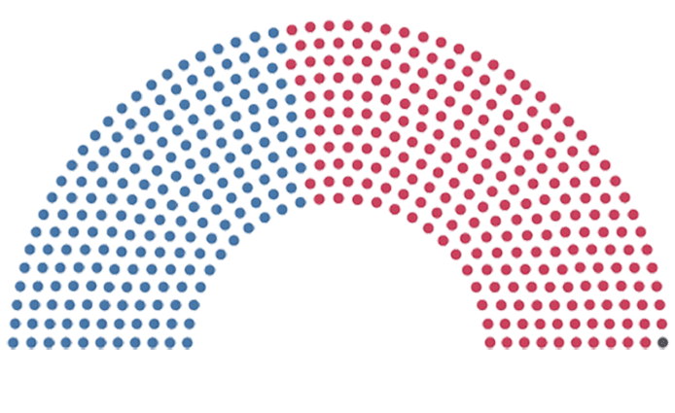
Election
Dashboard
function dashboard-project_2( ) { return (`{p.sulzen} <br> {a.tomazos} <br> {e.wills}`);
}
http://election-dashboard.herokuapp.com/
https://github.com/ejw-data/dashboard-project2

Slide 2
Congressional Voting Trends
project theme:
election 2020: 299 days left
a census year: 2020
congressional district evolution (2001-2017)
project datasets

Slide 3
Under the ‘hood:
http://election-dashboard.herokuapp.com/
our coding approach
programming languages, frameworks, libraries
app, database, platform, toolkit
data munging techniques

Slide 4
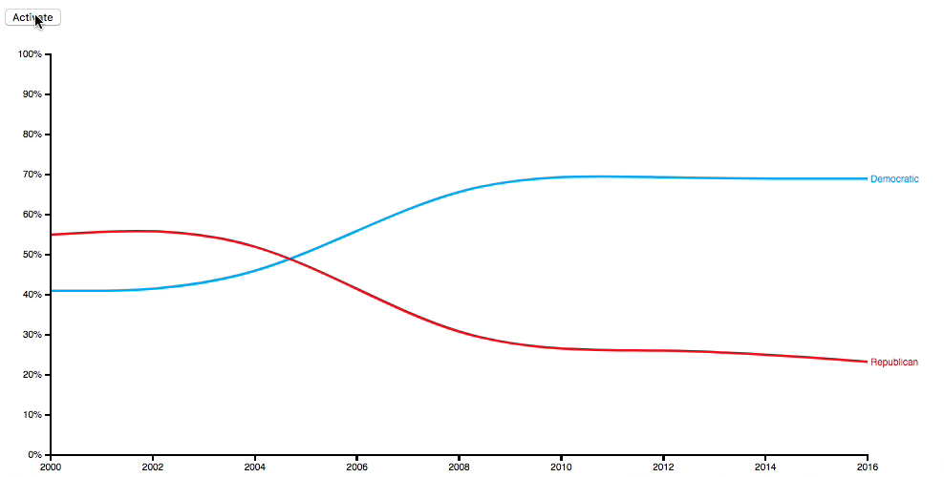
2 D3s: 1 multi-axes scatter + 1 “custom” creative
Visualizations : 5

Slide 5
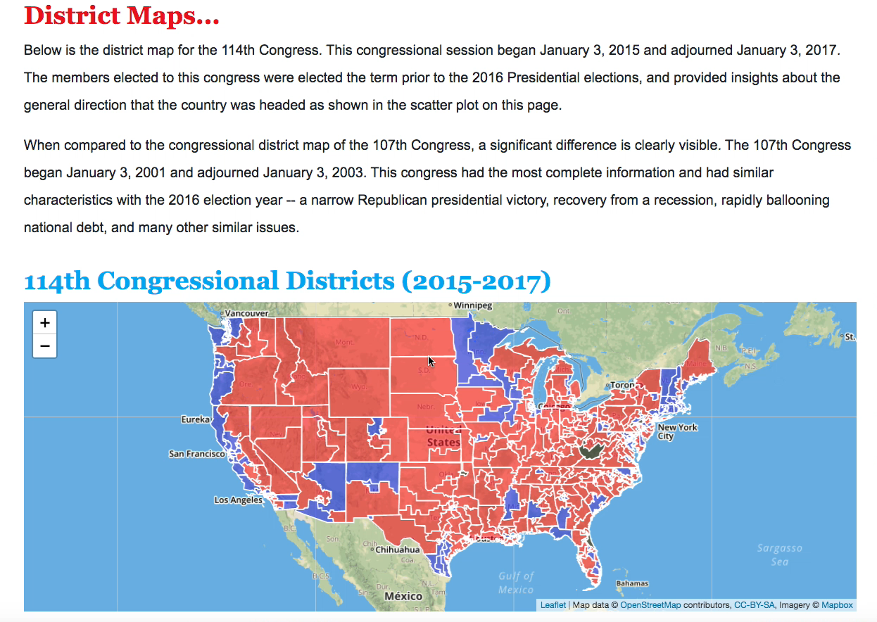
3 Leaflets
Interactivity

Slide 6
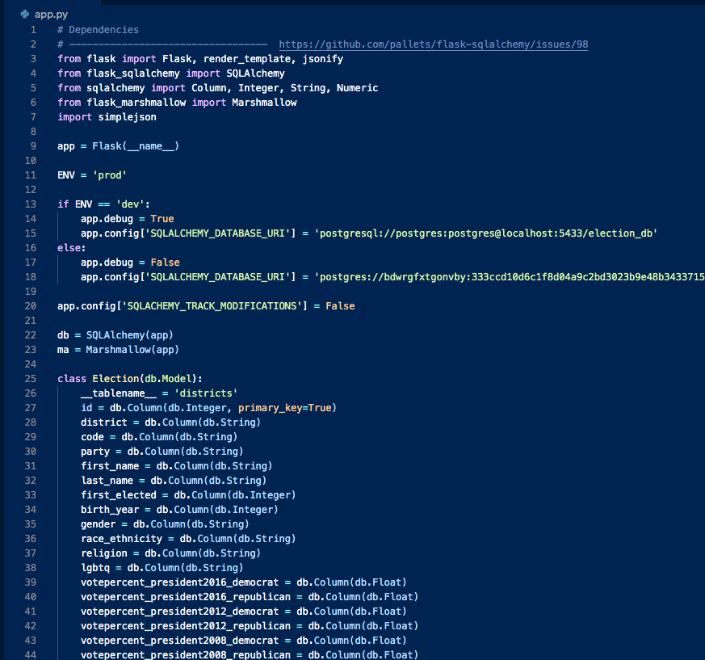
Deployment
http://election-dashboard.herokuapp.com/

Slide 7
Election
Dashboard
function dashboard-project_2( ) { return (`{p.sulzen} <br> {a.tomazos} <br> {e.wills}`);
}
http://election-dashboard.herokuapp.com/
https://github.com/ejw-data/dashboard-project2

